Slide 1

中国科学院大学：VLSI测试与可测试性设计
第十讲 逻辑电路故障诊断
叶靖、李晓维
中科院计算技术研究所
Notes:
EE141

Slide 2
Chapter 10
Logic Diagnosis
Notes:
EE141

Slide 3
Outline
Introduction
Combinational Logic Diagnosis
Scan Chain Diagnosis
Logic BIST Diagnosis
Conclusion
Notes:
EE141

Slide 4
What would you do when chips fail?
Is it due to design bugs?
  If most chip fails with the same syndrome when running an application
Is it due to parametric yield loss?
  Timing-related failure?
    Insufficient silicon speed?
  Noise-induced failure?
    supply noise, cross-talk, leakage, etc.?
  Lack of manufacturability?
    inappropriate layout?
Is it due to random defects?
  Via misalignment, Via/Contact void, Missing metal
  Unintentional short/open wires, etc.
Notes:
EE141

Slide 5







Problem: Fault Diagnosis
This chapter focuses more on diagnosis of defects or faults, not design bugs
Circuit
Under
Diagnosis
(CUD)
expected response
test patterns
=
not equal !
faulty response
a chip with defects inside
Question: Where are the fault locations ?
Notes:
EE141
Suppose this is a taped-out netlist and this is the fabricated silicon.
During testing, we drive the silicon by test patterns and then observe the output response. If this chip are not functioning up to its spec., then we need to figure out what is wrong with silicon so that we can fine-tune the process steps to improve our yield.
Since there could be millions of transistors in the chip, obviously we need some tool to narrow down the defect locations first before engineers can step in to really visually examine the wafer.

Slide 6
Diagnosis For Yield Improvement
Golden
Reference
Model
Physical Failure Analysis
Scanning Electronic Microscope (SEM)
Focused Ion Beam (FIB)
Logic Diagnosis
Via void
Mouse bite, etc.
Defect Mechanisms
A Set of
Potential
Defect Locations
Tune the Manufacturing
Process or Design
for Yield Improvement
Notes:
EE141

Slide 7
Quality Metrics of Diagnosis
Success rate
  The percentage of hitting at least one defect in the physical failure analysis
  This is the ultimate goal of failure analysis
Diagnostic resolution
  Total number of fault candidates reported by a tool
  The perfect diagnostic resolution is 1
  Though perfect resolution does not necessarily imply high hit rate
First-hit index
  Used for a tool that reports a ranked list of candidates
  Refers to the index of the first candidate in the ranked list that turns out to be a true defect site
  Smaller first-hit index indicates higher accuracy
Top-10 hit
  Used when there are multiple defects in the failing chip
  The number of true defects in the top 10 candidates
Notes:
EE141

Slide 8

Challenge
Do whatever you want,
but give me that damn bug(s) in less than 5 candidates.
failure analysis people
under time-to-market pressure
Notes:
EE141

Slide 9
Supporting Circuitry
Supporting Circuitry:
Makes Logic’s inputs controllable and outputs observable
FF
MUX
Test input
Logic
op_mode
Memory
FF
FF
Logic
shift
register
Scan out
Logic
Logic
Notes:
EE141

Slide 10
Design For Diagnosis
Complexity
of
Diagnosis
Original
Design
Interface circuitry
Separated
Logic &
Memory
Scan-chain
Logic Design
with Full-Scan
More Supporting Circuitry
Notes:
EE141

Slide 11
Possible Assumptions Used in Diagnosis
Stuck-At Fault Model Assumption
  The defect behaves like a stuck-at fault
Single Fault Assumption
  Only one fault affecting any faulty output
Logical Fault Assumption
  A fault manifests itself as a logical error
Full-Scan Assumption
  The chip under diagnosis has to be full-scanned
Note: A diagnosis approach less dependent on the fault assumptions
is more capable of dealing with practical situations.
Notes:
EE141

Slide 12
Examples of Faults
Node Fault
Short Fault (Bridging)
VDD
α
A
γ
β
bridging
C
Most diagnosis algorithms performs
at the gate level, trying to identify the
troubling signals or cells
B
A
GND
Notes:
EE141
Defects can occurs either at a device or interconnects. For example, in this NOR gates, the source and drain of this transistor can have a bridging effect. Similarly, two wires can be shorted together by a particle.

Slide 13
Byzantine Open Fault
Definition of Byzantine Fault:
  A fault that causes an ambiguous voltage level
‘1’
‘1’
G2
α ~ 2.5 v
pseudo ‘1’
G1
open fault
pseudo ‘0’
‘0’
‘1’
G3
Notes:
EE141

Slide 14
A Byzantine Node Type
VDD
Truth Table
C
driver to ‘1’
A | B | C | Z | Z^{f}
0 | 0 | 0 | 1 | 1
0 | 0 | 1 | 0 | 0
0 | 1 | 0 | 1 | 1
0 | 1 | 1 | 0 | 0
1 | 0 | 0 | 1 | ~0
1 | 0 | 1 | 0 | 0
1 | 1 | 0 | 0 | 0
1 | 1 | 1 | 0 | 0
B
Z
A
faulty
min-term
bridging
C
B
The faulty output
could be ambiguous
driver to ‘0’
GND
Notes:
EE141

Slide 15
Fault Classification
Fault in Logic IC
affects
functionality
affects
timing
Functional Fault
Delay Fault
Node Fault
Open Fault
Short Fault
Byzantine Fault
Gate-Delay
Fault
Path-Delay
Fault
Notes:
EE141

Slide 16
Outline
Introduction
Combinational Logic Diagnosis
  Cause-Effect Analysis
  Effect-Cause Analysis
  Chip-Level Strategy
  Diagnostic Test Pattern Generation
Scan Chain Diagnosis
Logic BIST Diagnosis
Conclusion
Notes:
EE141

Slide 17
Terminology
Device Under Diagnosis (DUD): The Failing Chip
Circuit Under Diagnosis (CUD): The Circuit Model
Failing Input Vector: Causes Mismatches
Failing chip
input
vector
v
x
o
o
o
x
mismatched PO
matched PO
matched PO
matched PO
mismatched PO
Gate-level CUD
Notes:
EE141

Slide 18
Cause-Effect Analysis
Fault dictionary (pre-analysis of all causes)
  Records test response of every fault under the applied test set
  Built by intensive fault simulation process
A chip is diagnosed (effect matching)
  By matching up the failing syndromes observed at the tester with the pre-stored fault dictionary

Slide 19
Fault Dictionary Example
A diagnosis session:
traverse from a path from root to a leaf
a
Circuit under
Diagnosis
g
b
c
{f₁, f₂, f₃, f₄, f₅}
output=0
output=1
(a) Circuit under diagnosis
v₁
{f₁, f₄, f₅}
{f₂, f₃}
Circuits | Test vectors in terms of (a, b, c)
 | v₁ | v₂ | v₃ | v₄ | v₅
fault-free | 0 | 0 | 0 | 0 | 1
f₁ | 0 | 1 | 1 | 1 | 1
f₂ | 1 | 1 | 1 | 0 | 1
f₃ | 1 | 0 | 0 | 1 | 1
f₄ | 0 | 0 | 1 | 0 | 0
f₅ | 0 | 1 | 1 | 0 | 1
0
1
0
1
v₂
v₂
f₄
{f₁, f₅}
f₃
f₂
0
1
v₄
f₅
f₁
(c) Diagnostic tree
(b) Full-response dictionary

Slide 20
Fault Dictionary Reduction – P&R
(a) Full-response table
Fault | Output Response (z₁, z₂)
 | t₁ | t₂ | t₃ | t₄
f₁ | 1 0 | 10 | 1 1 | 10
f₂ | 0 0 | 00 | 1 1 | 00
f₃ | 0 0 | 00 | 0 0 | 00
f₄ | 0 1 | 00 | 0 0 | 01
f₅ | 0 1 | 00 | 0 1 | 01
f₆ | 0 1 | 00 | 0 1 | 01
f₇ | 1 0 | 00 | 1 0 | 00
f₈ | 1 1 | 11 | 1 1 | 11
(c) P&R compression dictionary
Fault ID | Pass-fail + Extra outputs
 | t₁ | t₂ | t₃ | t₄
f₁ | 1 1 | 1 | 0 1 | 1
f₂ | 1 0 | 0 | 0 1 | 1
f₃ | 1 0 | 0 | 1 0 | 1
f₄ | 1 0 | 0 | 1 0 | 0
f₅ | 1 0 | 0 | 1 1 | 0
f₆ | 1 0 | 0 | 1 1 | 0
f₇ | 1 1 | 0 | 1 0 | 1
f₈ | 0 1 | 1 | 0 1 | 1
Fault | Pass (0) or Fail (1)
 | t₁ | t₂ | t₃ | t₄
f₁ | 1 | 1 | 0 | 1
f₂ | 1 | 0 | 0 | 1
f₃ | 1 | 0 | 1 | 1
f₄ | 1 | 0 | 1 | 0
f₅ | 1 | 0 | 1 | 0
f₆ | 1 | 0 | 1 | 0
f₇ | 1 | 0 | 1 | 1
f₈ | 0 | 1 | 0 | 1
Response of z₁
Response of z₂
(b) Pass-fail dictionary

Slide 21
Detection Fault Dictionary
(a) Full-response table
Fault ID | Output Response (z₁, z₂)
 | t₁ | t₂ | t₃ | t₄
f₁ | 10 | 10 | 11 | 10
f₂ | 00 | 00 | 11 | 00
f₃ | 00 | 00 | 00 | 00
f₄ | 01 | 00 | 00 | 01
f₅ | 01 | 00 | 01 | 01
f₆ | 01 | 00 | 01 | 01
f₇ | 10 | 00 | 10 | 00
f₈ | 11 | 11 | 11 | 11
failing output vectors
(c) Detection dictionary
Fault ID | Detection information (Test ID : Output Vector)
f₁ | t₁:10 t₂:10 t₄:10;
f₂ | t₁:00 t₄:00;
f₃ | t₁:00 t₃:00 t₄:00;
f₄ | t₁:01 t₃:00;
f₅ | t₁:01 t₃:01;
f₆ | t₁:01 t₃:01;
f₇ | t₁:10 t₃:10 t₄:00;
f₈ | t₂:10 t₄:11;
Fault ID | Pass (0) or Fail (1)
 | t₁ | t₂ | t₃ | t₄
f₁ | 1 | 1 | 0 | 1
f₂ | 1 | 0 | 0 | 1
f₃ | 1 | 0 | 1 | 1
f₄ | 1 | 0 | 1 | 0
f₅ | 1 | 0 | 1 | 0
f₆ | 1 | 0 | 1 | 0
f₇ | 1 | 0 | 1 | 1
f₈ | 0 | 1 | 0 | 1
(b) Pass-fail dictionary

Slide 22
Outline
Introduction
Combinational Logic Diagnosis
  Cause-Effect Analysis
  Effect-Cause Analysis
  Chip-Level Strategy
  Diagnostic Test Pattern Generation
Scan Chain Diagnosis
Logic BIST Diagnosis
Conclusion

Slide 23
Terminology: Mismatched Output
Effect-cause analysis does not build fault dictionary
It predicts fault locations by analyzing CUD from mismatch PO’s
failing chip
0
0
0
0
0
failing PO
failing PO
input
vector
v
1
0
0
0
1
mismatched PO
CUD
mismatched PO

Slide 24
Structural Pruning – Intersection or Union?
z₂
z₂
primary
inputs
z₃
z₃
CUD
Fault candidate set
(a) Cone intersection.
z₁
z₁
z₂
z₂
primary
inputs
z₃
z₃
CUD
Fault candidate set
(b) Cone union when there are multiple faults.

Slide 25
Backtrace Algorithm
Trace back from each mismatched PO
  To find out suspicious faulty locations
Functional Pruning
  During the trace-back, some signals can be disqualified from the fault candidate set based on their signal values.
Rules
  [1]At a controlling case (i.e., 0 for a NAND gate): Its fanin signals with non-controlling values (i.e., 1) are excluded from the candidate set.
  [2] At a non-controlling case (i.e., 1 for a NAND gate): Every fanin signal remains in the candidate set.

Slide 26
Backtrace Example
All suspicious fault locations are marked in red.
0
Target
mismatched
output
b
1
1
e
1
0
0
c
1
1
f
a
1
d
0
1

Slide 27
Terminology – Injection
An injection at a signal f flips its current value
which could create value-change events downstream.
x
o
o
x
x
f = ‘0’
x
o
o
x→o?
x
f = ‘1’
v
v
O: correct output
X: failing output
A mismatched output
could be fixed by the injection!

Slide 28
Terminology – Curable Output
Diagnosis Criterion
  A signal is more suspicious if it has more curable outputs
x
o
o
x
x
f = ‘0’
x
o
o
o
o
f = ‘1’
v
v
cured
cured
O: correct output
X: failing output
An injection at f fixes two mismatched outputs
➔ Thus, f has two curable outputs !

Slide 29
Terminology – Curable Vectors
v is a curable vector by f
➔ because an injection at f exists such that
it cures all mismatches without creating new one
Curable vector is a stronger diagnosis indicator than curable output !
x
o
o
x
x
f = ‘0’
o
o
o
o
o
cured
f = ‘1’
v
v
cured
cured

Slide 30
Example of Curable Vector
x₁ = 0
x₂ = 1
x₃ = 1
x₄ = 1
0
1
failing
(a) Failing Chip
x₁
0
1
f
1→ 0
cured
x₂
1→ 0
0→ 1
1
1
1
x₃
1
x₄
0
1
(b) Circuit Under Diagnosis

Slide 31
Why Curable Vector ?
Information theory
  A less probable event contains more information
  Curable output is an easy-to-satisfy criterion
  Curable vector is a hard-to-satisfy criterion
Not all failing input vectors are equal !
Niche input vector
  Is an failing input vector that activates only one fault
  Likely to be a curable vector of certain signals
  Few, but tells more about the real fault locations

Slide 32
Inject-and-Evaluate Paradigm
input vectors
design
model
failing chip
response
Calculate the no. of “curable vectors” of each signal
Calculate the no. of “curable outputs” of each signal
Sorting
Criteria
Sort the signals by the no. of “correctable vectors”,
If tied, sort by the no. of “correctable outputs”
ranking of each signal’s possibility
of being a defect location

Slide 33
Detailed Computation –
Inject-and-Evaluate Paradigm
CUD
net-list
failing
test vectors
failing chip
syndromes
Set initial candidate set by structural pruning
for each failing input vector v {
Step 1: perform logic simulation;
Step 2: for each candidate signal f {
Step 2.1: flip the value at f ; /* injection */
Step 2.2: run event-driven fault simulation; /*evaluation */
Step 2.3: calculate certain metrics /* ranking */
}
}
Sort the candidate signals by the calculated metrics;
a list of ranked candidate signals

Slide 34
Reward-and-Penalty Heuristic
Rank1: curable vector count
Rank2 = (curable output count – 0.5 * new mismatched output count)
x₁ =0
x₂ =1
x₃ =1
x₄ =0
0
1
failing
passing
(a) Failing Chip.
x₁
0
1
1→ 0
cured
f
x₂
1→ 0
1
0→ 1
new
mismatch
1→0
1
x₃
1
0
1
x₄
(b) Circuit Under Diagnosis.

Slide 35
Targeting Bridging Faults
Even in a realistic bridging fault, there is only one victim at any time.
This victim will expose his location by owning some curable vectors.
A
w₁
B
bridging
C
D
w₂

Slide 36
SLAT Paradigm
Ref: SLAT (Single Location At a Time) paradigm [Bartenstein 2001]
Note: A SLAT vector is a curable vector
CUD
failing
input vectors
failing chip
response
Phase 1: Finding SLAT (Single Location at A Time) vectors:
(1) Fault simulation, (2) Output matching
Phase 2: Finding valid fault multiplets
(1) Finding single-fix candidates
(2) Finding double-fix candidates
(3) Finding triple-fix candidates, etc.
A number of valid fault multiplets

Slide 37
Example: SLAT Paradigm
Failing Input Vectors | Signals in the CUD
 | f₁ | f₂ | f₃ | f₄ | f₅ | f₆ | f₇
v₁ | * |  |  |  | *
v₂ | * | * | *
v₃ |  |  | * | * |  |  | *
v₄ |  |  |  |  | * | *
v₅ |  | * |  |  | *
v₆ |  | * |  |  | *
v₇ | * |  | *
v₈ |  |  | * |  |  |  | *
v₉ |  |  | * |  | *
v₁₀ |  |  |  |  | * |  | *
A mark * means the corresponding vector is
a SLAT vector of the corresponding signal.
(f₃ and f₅)
is a valid fault multiplet

Slide 38
Outline
Introduction
Combinational Logic Diagnosis
  Cause-Effect Analysis
  Effect-Cause Analysis
  Chip-Level Strategy
  Diagnostic Test Pattern Generation
Scan Chain Diagnosis
Logic BIST Diagnosis
Conclusion

Slide 39
Structurally Dependent and Independent Faults
fault f₁
z₁
mismatched output
fault f₂
z₂
mismatched output
inputs
z₃
mismatched output
fault f₃
Fault f₁ is an independent fault.
Faults f₂ and f₃ are dependent faults.

Slide 40
Dependency Graph
Direct divide-and-Conquer
does not work well !
z₁
fault f₁
z₂
dependency graph
z₁
fault f₂
z₃
z₂
z₃
one connected component
Two independent faults, f₁ and f₂, lead to one diagnosis block.

Slide 41
Main Strategy:
Detach-Divide-and-then-Conquer
Phase 1: Isolate Independent Faults
  Search for prime candidates
  Use word-level information
Phase 2: Locate Dependent Faults As Well
  Perform partitioning
  Aim at finding one fault in each block

Slide 42
Prime Candidates
A signal f is a prime candidate if
(1) All failing input vectors are partially curable by f
(2) Curable-Output-Set(f) is not covered by any other’s
f1
syndrome
set 1
f3
f1 & f2
are prime !
f2
syndrome
set 2

Slide 43
Fake Prime Candidates
Structurally Independent Faults
  are often prime candidates
Fake Prime Candidates
  are prime candidates that are NOT really faults
f3
Example: Dependent Double Faults f1 & f2
May create fake prime candidates {f3, f4, f5}.
f1
f4
f2
f5

Slide 44
Overall Flow
failing
input vectors
design
model
failing chip
response
  Phase 1:
    (1) Find Prime Candidates
  Phase 2:
    (1) Remove explained outputs and their fanin cones
    (2) Partition the rest model into blocks
    (3) Perform diagnosis for each block
Rank candidates produced
in phases 1 & 2

Slide 45
Summary
Strategy
  (1) Search For Prime Candidates
  (2) Identify Independent Faults First
  (3) Locate Dependent Faults As Well

Slide 46
Outline
Introduction
Combinational Logic Diagnosis
  Cause-Effect Analysis
  Effect-Cause Analysis
  Chip-Level Strategy
  Diagnostic Test Pattern Generation
Scan Chain Diagnosis
Logic BIST Diagnosis
Conclusion

Slide 47
Diagnostic Test Pattern Generation
a₁
DTPG helps to increase diagnostic resolution
e
a
d
d₁
g
b
Model for differentiating vector generation
c
d₂
d₁ stuck-at 1
a₂
f
a
e
fault-free circuit
⊕
b
d
g
c
d₂
x
a₂
f
z/0
d₂ stuck-at 0
⊕
e
d
d₁
g
a₂
f

Slide 48
Outline
Introduction
Combinational Logic Diagnosis
Scan Chain Diagnosis
  Preliminaries
  Hardware-Assisted Method
  Signal-Profiling Based Method
Logic BIST Diagnosis
Conclusion

Slide 49
Scan Test and Diagnosis
Flush test of scan chains
(pumping random patterns and checking response)
Pass or Fail?
Pass
Fail
Test Combinational Logic
Find failing scan chain(s)
Classify fault types
Scan Chain Diagnosis

Slide 50
Commonly Used Fault Types in Scan Chains
Scan Chain Faults
Functional Faults
Timing Faults
Stuck-at
Bridging
Setup-Time
Violation Fault
Hold-Time
Violation Fault
Slow-To-Rise
Fault
Slow-To-Fall
Fault
Each fault could be permanent or intermittent.

Slide 51
A Stuck-At Fault In the Chain
Effect: A killer of the scan-test sequence
input
pins
Combinational Logic
output
pins
scan-input
(SI)
scan-output
(SO)
MUX
D
Q
MUX
D
MUX
11010100
Q
D
Q
00000000
s-a-0
?
All-0 syndrome
scan-enable
clock
Notes:
EE141
A fault in the scan chain is very different from a fault in the core logic.
Typically, it will have a global effect that may overwhelm the output response one will observe at the scan output pin of the chip.
Here is an example. Suppose that we have a stuck-at-0 fault somewhere in the scan chain. Then, we will get all-0 syndrome no matter what input pattern we flushed into the scan chain. Here a stuck-at fault kills all signals passing through it.

Slide 52
Example: Faulty Syndrome of a Scan Chain
A scan chain
SI
(scan input pin)
SO
(scan output pin)
A faulty flip-flop
Fault Type | Scan-In Pattern | Observed Syndrome
Stuck-at-0 | 1100110011001100 | 0000000000000000
Stuck-at-1 | 1100110011001100 | 1111111111111111
Slow-to-Rise | 1100110011001100 | 1000100010001000
Slow-to-Fall | 1100110011001100 | 1101110111011100
The rightmost bit goes into the scan first
The rightmost bit gets out of the scan first
A underlined bit in the observed image is failing.

Slide 53

Augmentation of a Flip-Flop for Easy Diagnosis
(From logic)
MUX
DFF
D
Q
(from scan chain)
SE
(a) A normal scan flip-flop.
(From logic)
MUX
DFF
(from scan chain)
D
Q
Invert
SE
(b) A modified scan flip-flop for easy inversion.

Slide 54
Fault Location via Inversion Operation
A scan chain
SI
SO
Stuck-at-0
SI-to-fault
Fault-to-SO
Original bit-stream pattern = (1111111111111111)
After scan-in: snapshot image = (1111000000000000)
After inversion: snapshot image = (0000011111111111)
After scan-out: observed image = (0000011111111111)
The fault location is at the edge between 0’s and 1’s

Slide 55
Definition: Snapshot Image
Def: A snapshot image is the combination of flip-flop values
at certain time instance
Mission Logic
output
pins
input
pins
Scan
input
(SI)
Scan
output
(SO)
MUX
0
MUX
1
MUX
0
MUX
1
D
Q
x
F₁
F₂
s-a-0
F₃
F₄
clock
Snapshot image: {(F₁, F₂, F₃, F₄) | (0, 1, 0, 1)}
Notes:
EE141
In this presentation, a snapshot image is referred to the combination of the flip-flop values at certain time instance.
For example, the snapshot image of this scan chain is now {0, 1, 0, 1} counting from the scan input pin.
Normally, a snapshot image is not accessible in a chip. However, we can simulate the fault-free circuit model to get the fault-free snapshot image under a particular input vector or input sequence.

Slide 56
Definition: Observed Image
Def: An observed image is the scanned-out version of
a snapshot image.
Mission Logic
output
pins
input
pins
Scan
input
(SI)
Scan
output
(SO)
MUX
0
MUX
1
MUX
0
MUX
1
D
Q
x
F₁
F₂
s-a-0
F₃
F₄
clock
Snapshot image: {(F₁, F₂, F₃, F₄) | (0, 1, 0, 1)}
Observed image: {(F₁, F₂, F₃, F₄) | (0, 0, 0, 1)}
Notes:
EE141
To retrieve an image, we need to scan it out. The resulting image could be distorted by the fault and referred to as observed image.
For a fault-free circuit model, the observed image is the same as the snapshot image. For a failing chip identified to have some faults in the scan chain, these two images are mostly different.
For example, here the values of flip-flop F1 and F2 got corrupted by the fault, leading to a difference observed image as (0,0,0,1) at the SO (scan output) pin.

Slide 57
Modified Inject-and-Evaluate Paradigm
Step 2: Capture the response to FF’s
Step 1: Scan-in an ATPG pattern
core
logic
core
logic
x
1
0
0
0
1011
x
x
x
x
x
core
logic
A stuck-at-0 fault is assumed
at the output of the 2nd FF from SI
0010
x
0
1
1
0
Step 3: Scan-out and compare

Slide 58
Test Application: Run-and-Scan
Step 1: Apply a test sequence from PI’s
➔ Setting up a snapshot image at FF’s
Test
Sequence
core
logic
S-A-0
core
logic
x
0
1
1
0
Less distorted image
S-A-0
x
0010
0
1
1
0
SO
up-stream part
will be distorted
Step 2: Scan-out an observed image
The fault location is embedded in the observed image
Notes:
EE141
We can use the run-and-scan test application in which we apply a sequence of input vector from the primary input pins, setting up a particular snapshot image inside the chip.
Then, we scan it out. In this step, only the up-stream is distorted, whereas the down-stream part of the image remain mostly intact as compared to the fault free one.
This observation is useful in diagnosis. The observed image can be divided into two parts: (heavily distorted part) + (rarely distorted part). The faulty flip-flop is very likely at the boundary of these two parts.

Slide 59
Signal Profiling
A profile is the distribution of certain statistics of the flip-flops.
Failing chip
core
logic
faulty flip-flop
Scan
Shifting
x
Test
Sequences
0.41
0.51
0.61
0.41
0
0
0.65
0.35
perturbed image
Up-stream
Down-stream
core
logic
different
similar
0.4
0.5
0.6
0.4
0.4
0.5
0.6
0.4
fault-free image
Fault-free profile
Comparing failing profile with the fault-free profile
➔ Could reveal the fault location
Fault-free model
Notes:
EE141
In the sequel, a profile is about the distribution of some statistics on the flip-flops.
The most important concept in our approach is that we can locate the scan fault by analyzing the difference between the failing profile of the chip with the fault-free profile, under a number of test sequences.
It is worth mentioning that, the snapshot image of the failing chip (as illustrated) is only slightly affected by the scan fault even when there are other faults in the core logic. Here, we refer it to as perturbed image. Such minor distortion will not cause too much trouble in our final results.
The observed failing profile is mostly distorted by the scan out process.

Slide 60
Profile Analysis
Fault-free images
(say 100 of them)
Failing images
(say 100 of them)
Collected from tester
Derive the fault-free profile
Derive the failing profile
Derive the difference profile
A difference image
= fault-free image ⊕ failing image
Perform filtering on the difference profile
report
a ranked list
of fault locations
Perform edge detection to derive ranking profile
Notes:
EE141
The overall flow of our approach is shown here.
(1) First, we generate the diagnostic test sequences, say 100 of them.
(2) By checking the simulation dump file, we can get their fault-free images instantly.
(3) We apply these test sequences to the failing chip, collecting 100 failing images.
(4) Then, we perform bit-by-bit XOR on each failing image and fault-free image, obtaining a difference image. Among the 100 difference images, we can obtain a difference profile.
(5) We then perform filtering and edge detection on the difference profile to arrive at a ranking profile.
In the ranking profile, a flip-flop with a higher value is considered as more likely to be one of the fault sites.
Due to the time limitation, the details of the filtering and edge detection are referred to our paper.

Slide 61
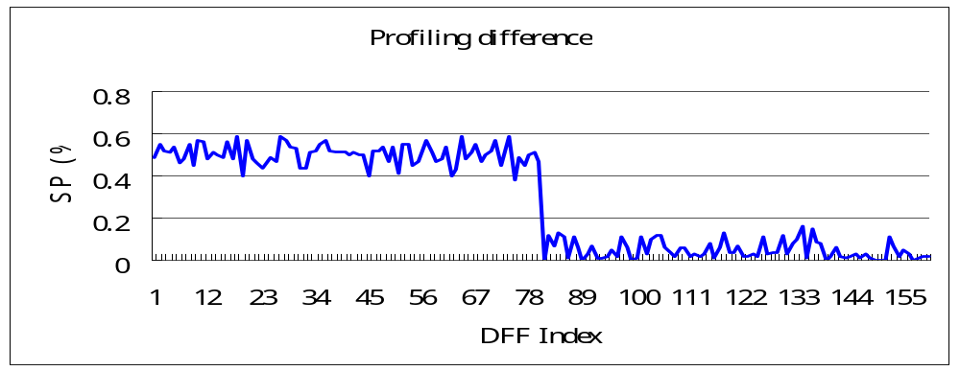
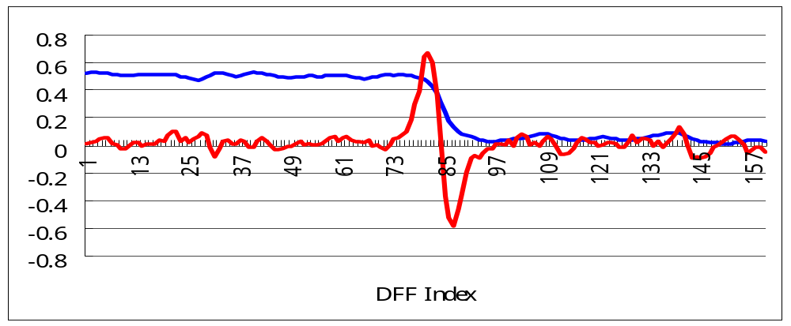
Example: Filtering & Edge Detection
Difference Profile
Signal-1 Frequency (%)
Filtering & Edge Detection
Filtered Difference Profile
Ranking (or suspicion) Profile
Smooth Profile
Ranking Profile
Scan Input ← FF index → Scan Output
Notes:
EE141
If we take the difference profile, it will look like this.
It has two sections, the up-stream and the down-stream.
To make the fault location easier, we performing filtering and edge detection to derive the ranking profile, where a peak reveals the location of a scan fault.
It is worth mentioning that we do not use any fault model in the above analysis at all.

Slide 62
Computation of Average-Sum Filtering
(Average-sum filtering) Assume that the difference profile is given and denoted as D[i], where i is the index of a flip-flop. We use the following formula to compute a smoothed difference profile, SD[i]:
SD[i] = 0.2*(D[i-2]+ D[i-1]+ D[i]+ D[i+1]+ D[i+2])

Slide 63
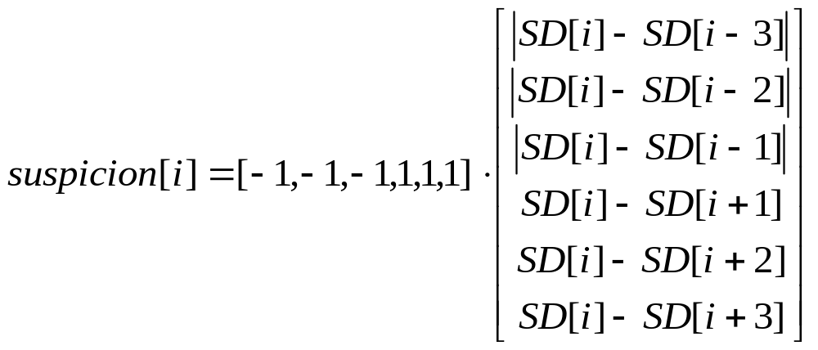
Computation of Edge Detection
The true location of the faulty flip-flop is likely to be the left-boundary of the transition region in the difference profile. To detect this boundary, we can use a simply edge detection formula defined below.
(Edge detection) On the smoothed difference profile SD[i], the following formula can be used to compute the faulty frequency of each flip-flop as a suspicious profile.

Slide 64
Summary of Scan Chain Diagnosis
Hardware Assisted
  Extra logic on the scan chain
  Good for stuck-at fault
Fault Simulation Based
  To find a faulty circuit matching the syndromes [Kundu 1993] [Cheney 2000] [Stanley 2000]
  Tightening heuristic → upper & lower bound [Guo 2001][Y. Huang 2005]
  Use single-excitation pattern for better resolution [Li 2005]
Profiling-Based Method
  Locate the fault directly from the difference profiles obtained by run-and-scan test
  Applicable to bridging faults
  Use signal processing techniques such as filtering and edge detection

Slide 65
Outline
Introduction
Combinational Logic Diagnosis
Scan Chain Diagnosis
Logic BIST Diagnosis
Conclusion

Slide 66
A Logic BIST Architecture
PRPG (Pseudo-Random Pattern Generator)
Core
Logic
MISR (Multiple-Input Shift Register)
scan out
(as the signature)
All flip-flops are assumed to be observable
through scan chains.

Slide 67
Diagnosis for BISTed Logic
Diagnosis in a BIST environment requires
  determining from compacted output responses which test vectors have produced a faulty response (time information)
  determining from compacted output responses which scan cells have captured errors (space information)
The true fault location inside the logic
  Can then be inferred from the above space and time information using previously discussed combinational logic diagnosis

Slide 68
Outline
Introduction
Combinational Logic Diagnosis
Scan Chain Diagnosis
Logic BIST Diagnosis
Conclusion

Slide 69
Conclusions
Logic diagnosis for combinational logic
  Has been mature
  Good for not just stuck-at faults, but also bridging faults
Scan chain diagnosis
  Making good progress …
  Fault-simulation-based, or signal-profiling based
Diagnosis of scan-based logic BIST
  Hardware support is often required
  Interval-unloading, or masking-based
Future challenges
  Performance (speed) debug
  Diagnosis for logic with on-chip test compression and decompression
  Diagnosis for parametric yield loss due to nanometer effects

